Slide 1
Predictive analysis FOR in-hospital mortality OF icu patient’S
Manish Lomada
Akshat Karambe
Sumedh Kulkarni
Prajwal Parlawar

Slide 2

Acuity scores, such as APACHE, SAPS, MPM, and SOFA, are widely used to account for population differences in studies aiming to compare how medications, care guidelines, surgery, and other interventions impact mortality in Intensive Care Unit (ICU) patients.
Data consisted of 4000 patients which had 36 time series parameters (measurements of vital signs and laboratory results) from the first 48hrs of the first available ICU stay and 6 generic parameters which were recorded during the admission of the patient.
The generic parameters were Gender, Age, Height and time series parameters measured were HR, BP, Albumin and etc.

Slide 3

The main objectives of our project are
To find the parameters which majorly contribute towards the outcome of patient’s mortality and decrease the dimensionality of the data
To find the best possible model in the classification of data
Interpret the results and estimate the accuracy and sensitivity of the most optimal model determined

Slide 4
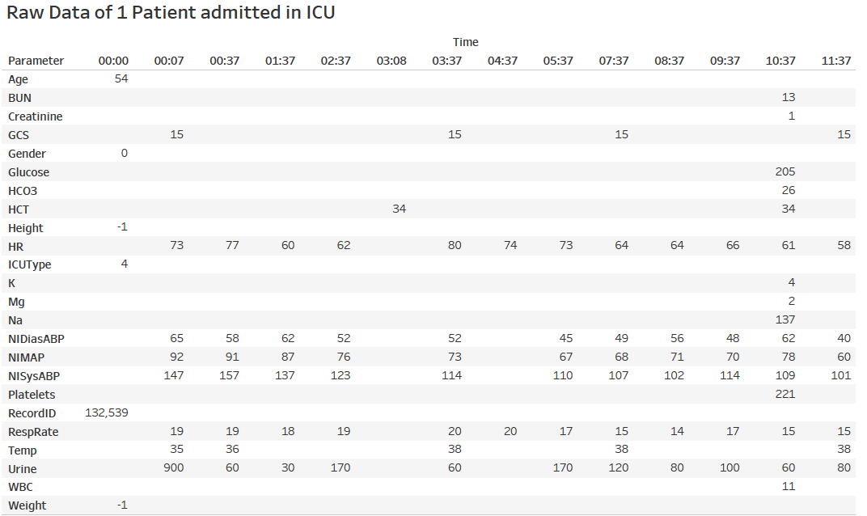

Data Extraction & Data Cleaning : Part 1
Had 4000 files of Patients in text format as our data
Determined mean for all the repeating parameters in the 48hrs span during the ICU Stay

Slide 5
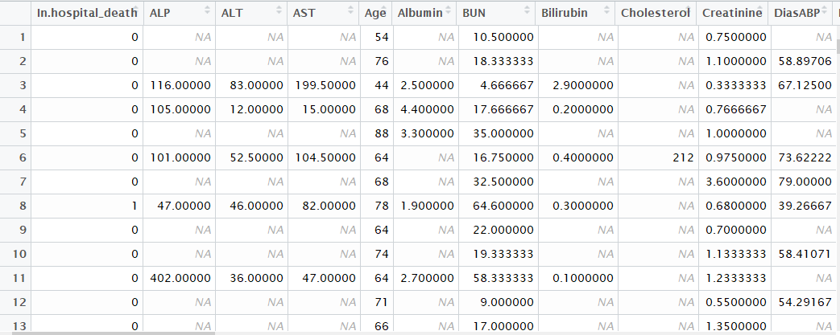
Data Extraction & Data Cleaning : Part 2
This is the result after applying the previous step to all the data
Proceeded to remove most of the generic parameters which don’t contribute towards the outcome of patient’s mortality rate
Removed those columns which had more than 60% of missing values
Eliminated rows having more than 68% of missing values

Slide 6
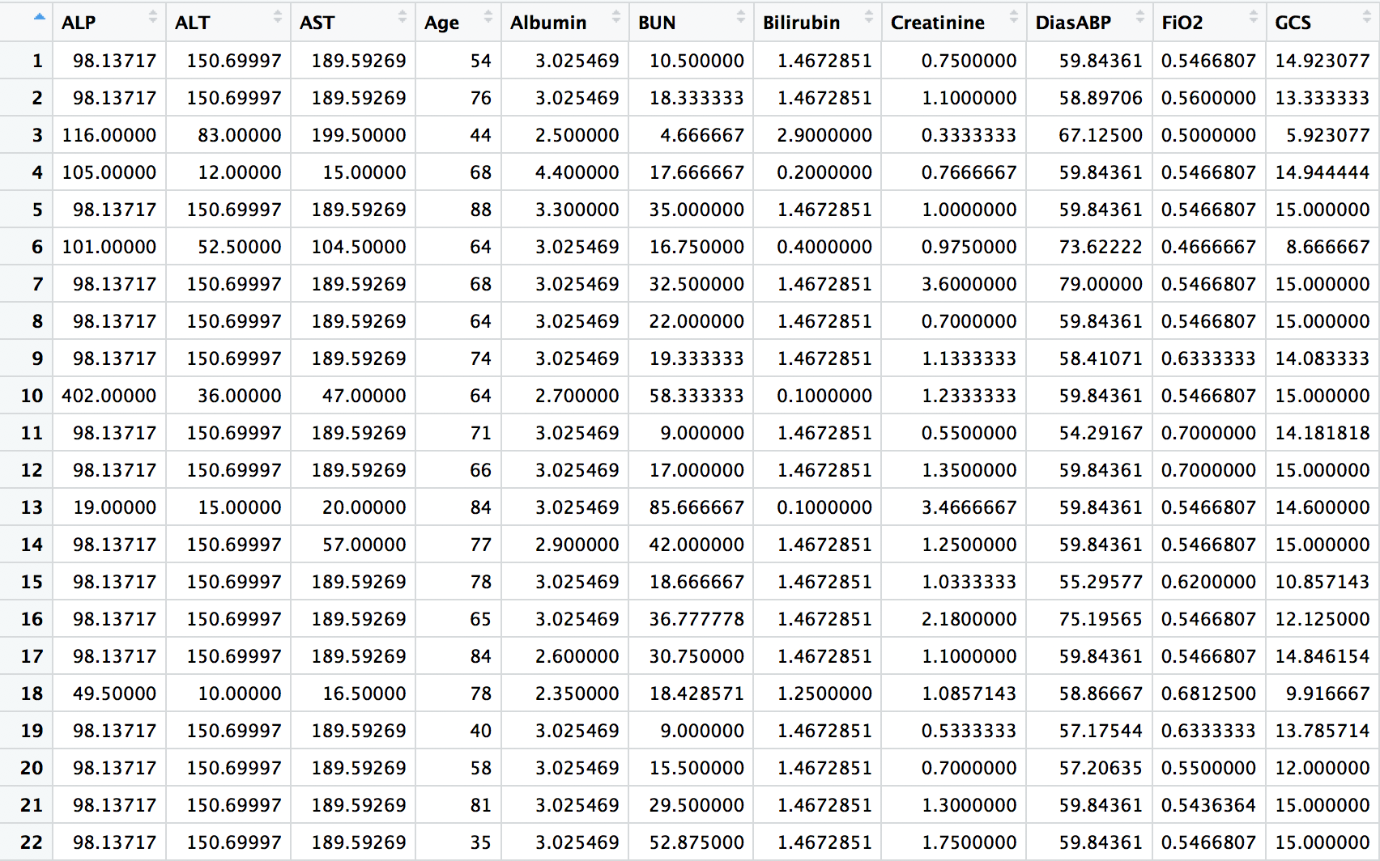
Data Extraction & Data Cleaning : Part 3
Replaced the missing values with the mean of the parameters for all the patients per column
Observed that conditions of patients who are alive vary from parameters of patients who are deceased after the 48 hour stay in ICU
So, divided the data based on the patient’s condition into two parts
First list of patients who were alive after their stay in ICU and second list of patients who were deceased after their stay in ICU
Found the mean value of parameters and replaced the missing values with it based on the patients being alive or dead

Slide 7
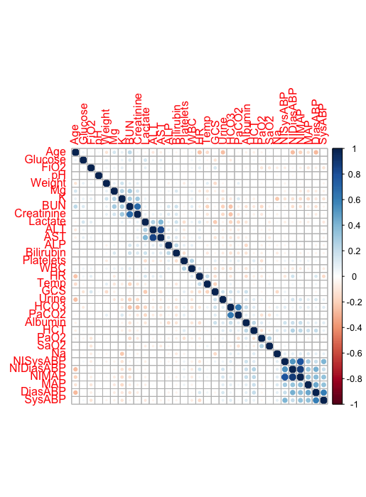
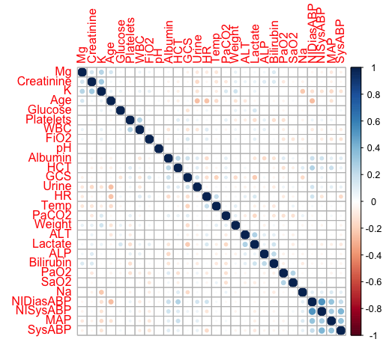
Data Reduction
After scaling the data, found out the correlation between the parameters
Got rid of the parameters which had high correlation rate (>60%)
So 33 parameters reduced down to 28 parameters after applying correlation analysis.

Slide 8


Balancing Data & Cross Validation
The data had highly imbalanced classes with 86.1% of the survived class and only 13.9% of the death class
We used library ROSE (Random Over-Sampling Examples) to overcome this issue
We use combination of over and under – sampling which balanced the samples by random over-sampling
minority samples and under-sampling the majority samples
After balancing the data we ran 5 fold cross validation.

Slide 9
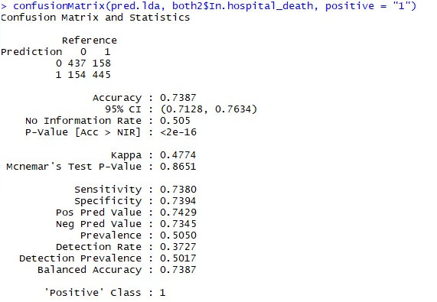
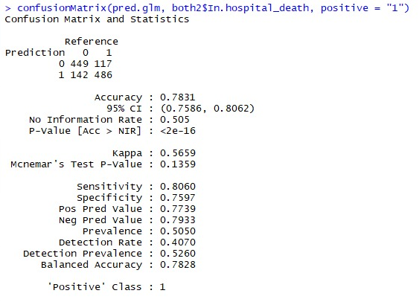
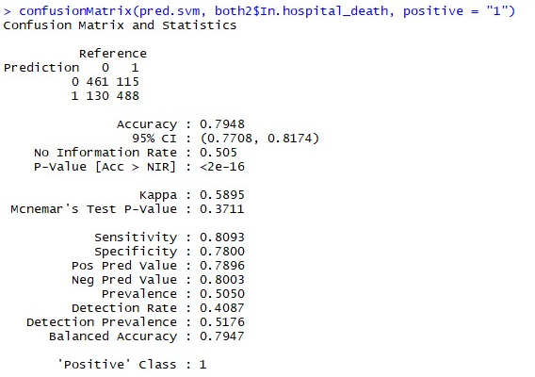
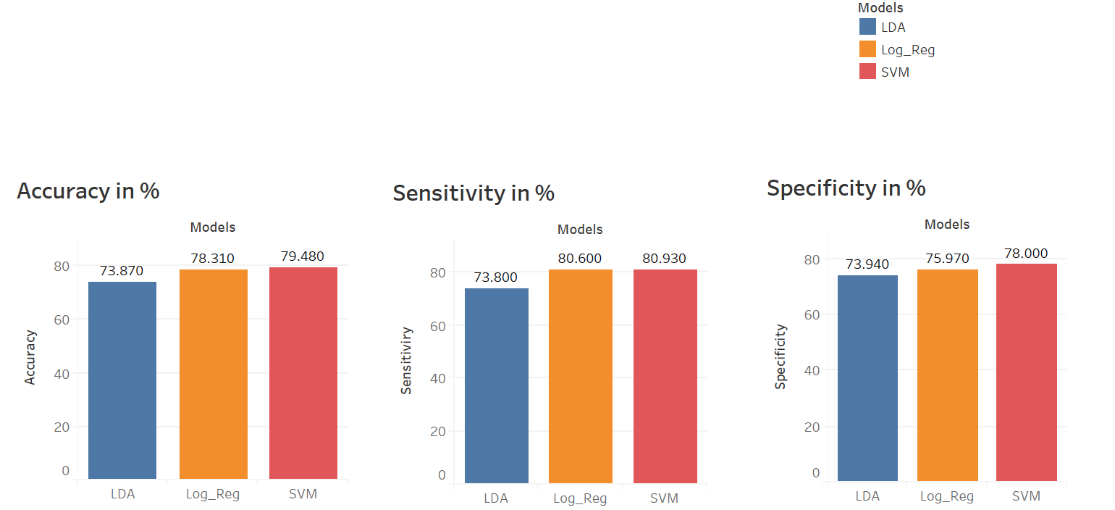
Modelling
We used 3 classification models viz Logistic Regression, Linear Discriminant Analysis & Support Vector Machine
LDA
LOG REG
SVM

Slide 10


